Slide 1
Motor vehicle Procedure
Updates-Managers Toolkit

Slide 2
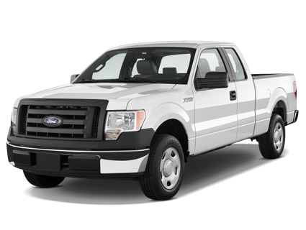
Motor Vehicle Procedure - Updates
In FieldCore our employees do High Risk Activities everyday . . .
Working at Heights
Testing Electrical Systems
Entering Confined Spaces
Lifting Heavy Loads
High Risk Activity that almost all of us do every day . . .
Driving
#1
We have 18 work related vehicle accidents YTD and there were 16 vehicle accidents during commute including a fatality and another one requiring months of hospitalization.
Notes:
Most people do not think of driving as a high risk activity; it is something we do everyday. But if you think about it, motor vehicle accidents are quite likely to result in severe injury, property damage or death. There are also a lot of specific rules of the road that must be followed in addition to training, having a license and safety equipment related to driving a motor vehicle. Very similar to our other high risk work activities.

Slide 3
Motor Vehicle Procedures - Updates
Major Changes - Consolidated multiple Motor Vehicle Safety Procedures
Driver Fatigue and Journey Management
Pedestrian and Worker Safety around Motor Vehicle
No active Cell phone use during driving (GPS, listening to music allowed)
Vehicle Maintenance, Inspection, Safety features
Training
Vehicle
Journey
Driver
Notes:
Many of the elements of the Motor Vehicle Procedure are unchanged. Previously there were two different documents that addressed Motor Vehicle Safety – an HR Policy and an EHS Procedure. These two documents have been consolidated into one that will reside on the EHS SharePoint site. Items related to License acknowledgments, records checks that were in the HR Motor Vehicle Policy have been retained in this updated procedure. This procedure does not make any changes to the eligibility and issuing of Company Leased or Owned Vehicles. This presentation focuses on changes to the Motor Vehicle Safety Procedure.

Slide 4
FieldCore Data
2019 YTD –started reporting all incidents only from Jan 2019
  18 Incidents related to work,
  16 incidents related to commute / non-work,
  1 fatality,
  1 serious injury requiring multiple months of hospitalization
Since Aug 2017 – 69 Total incidents. Poor reporting so far. Did not investigate incidents thoroughly so far.
Notes:
Driving related incidents are reported in all regions. It is a global risk for FieldCore.
80% of the incidents happen in clear weather and dry roads.

Slide 5
Phone use

Slide 6
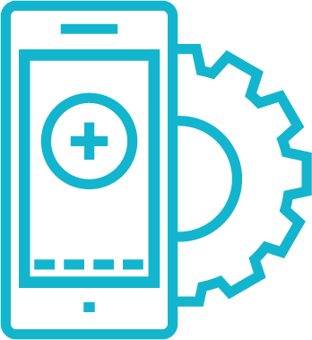
Motor Vehicle Procedures
PLAN
PREPARE
DRIVE
Mobile Phone Use Update:
Use of mobile phones or other electronic device, including hands-free, while driving is prohibited this includes:
  Making or receiving calls
  Texting
  Use of social media or other communication
  Participate in conference calls
Passive use of mobile phones such as GPS directions, or music is allowed – but cannot adjust while driving
Notes:
This is the change that will most impact people. Prior to this FieldCore discouraged mobile use, but per company policy allowed use of hands-free devices while driving. We are making a change because of overwhelming evidence that hands free use of mobile phones while driving presents a significant danger to the driver, passengers, and other vehicles on the road. We will spend the next few slides discussing some of the research that has been done in this area and why hands free is not risk free.
Please note that mobile phones may still be used in a passive manner example GPS driving directions or playing music. Note if adjustments need to be made drivers must find a safe spot to pull over and make the adjusts.
This procedure applies to the following situations:
Traveling for business regardless of vehicle type
When driving a company owned or leased vehicle, this includes authorised spouses/partners and dependents as drivers.
When using a company issued electronic device or phone, and
When engaging in company calls or other electronic communication.

Slide 7
Why are we making this change?
Distracted Drivers are more than 4 times likely to be involved in crash
Statistics show:
National Transportation Safety Board has recommended States adopt legislation banning all phone use while driving
>25% of Fortune 500 companies including many of our customers have banned all phone use while driving
Employers can be held liable for crashes involving their employees when driving on company business
In US cell phone use while driving leads to 1.6 million crashes each year.
300,000+ serious injuries from these crashes.
After decades of decreasing,
MVA’s have been on the rise since 2011
Smartphones sales grew after 2011.
Only major change in US road behaviors since 2011.
Notes:
In 2011 the US National Transportation Safety Board issued a recommendation that states enact legislation to ban use of mobile phones including hands free use. While government has been slow to react, many companies have been proactive in prohibiting all use of mobile phones while driving. As far back as 2012 more that 25% of Fortune 500 companies have banned all phone use while driving. This includes many of our customers such as Shell, BP, DuPont, ExxonMobil, Johnson & Johnson and Cargill. The majority of these companies have found no negative impact on productivity. (around 1.5% said that it decreased productivity) In fact >10% of companies surveyed said they actually felt a productivity increase.
Recently there have been lawsuits filed against employers for accident involving their employee who were using phones while driving on company business. Awards of up to $21 million to the injured parties have been issued.
But the main reason is FieldCore wants to provide a safe workplace for our employees including when they are on the road. Studies have show that 27% of motor vehicle accidents involve some type of cell phone use of those 6% involves texting, 21% phone conversations.
https://www.bts.gov/content/motor-vehicle-safety-data

Slide 8


MULTI-TASKING IMPAIRS PERFORMANCE
HANDS FREE IS NOT RISK FREE
Driving w/active sentence listening
Driving Alone
Green is part of the brain that processes visual information
Hands-Free Devices - do not eliminate cognitive distraction
The Brain quickly toggles between tasks, but can’t do two things at the same time
Brain activity decreases by over 1/3 when talking on a phone (handheld or handsfree doesn’t matter)
Source: NSC.org
Notes:
To understand why use of phones while driving is not risk free, we need to understand how the brain processes information. Both driving and carrying on a conversation are thinking tasks. The brain cannot perform multiple thinking tasks at one time – rather it toggles between the two tasks not doing either one of them effectively. This is know as cognitive distraction and occurs whether or not you are using hands free or hand held phones.
A study conducted at Carnegie Mellon University, subjects were placed in driving simulators while MRI pictures were taken, in order view activity in the brain. Pictures were taken when the subjects were simply driving in the simulator and again when they were asked true/false questions and driving at the same time – this was to simulate being on the phone while driving. In the second picture you can see that there is a big decrease in active brain function. The portion of the brain in green is that part that is used to process visual information including movement – which is critical to being able to drive safely.
Now people often ask – What if I am having a conversation with a passenger in the car? Is that as distracting? The answer is no for a couple of reasons. The passenger acts as a second set of eyes and may assist in observing changes in traffic conditions. You may have noticed that passengers often get quiet when driving conditions require additional focus. i.e., bad weather or traffic
The passenger will adjust the conversation depending upon overall conditions, however, the person on the other end of the phone has no idea what the overall conditions are; therefore they make no adjustments and then expect an answer as if you were sitting at your desk.
As for listening to the music or podcasts this is considered passive listening and does not put the same load on your brain as you are not trying to think of an answer or engage in a discussion.

Slide 9
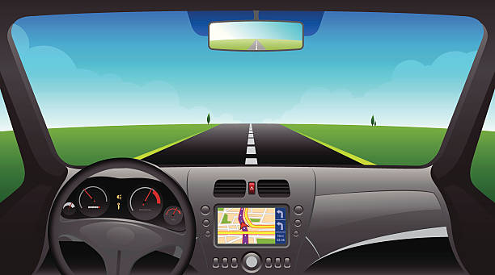


Inattention Blindness
You don’t know what you don’t see
Normal field of view
Field of view narrows while talking on a phone
When talking on the phone – either hand-held or hands free
Drivers can miss seeing up to 50% of what’s around them Including:
Pedestrians
Traffic Signals
Turning Cars
Notes:
Drivers on the phone also experience what is know as inattention blindness. This means that the driver may be looking but they are not processing visual information. A study done by Transport Canada used cameras inside vehicles to track where drivers eyes looked while driving. In the picture above the black box indicates where drives look during normal driving, the red box shows where their eyes looked when talking on the phone. Note this does not matter if the phone is hand held or hands free inattention blindness still occurred. Drivers in this study often ignored looking in mirrors, noticing traffic lights, and monitoring instruments while talking on the phone.
People are not aware of what information they are missing – they think that they are seeing everything that they need to drive safely. Some of the information missed with inattention blindness include pedestrians who may be getting ready to cross the street, traffic lights, and vehicles preparing to enter traffic.

Slide 10


MYTH:
Drivers talking on cell phones still have a quicker reaction time than those who are driving under the influence.
REALITY:
A Controlled driving simulator study conducted by the University of Utah found that drivers using cell phones had slower reaction times than drivers with blood alcohol content at the legal intoxication limit,
-VS-
WORSE!
Notes:
During this study both hand held and hands free cell phone use was measured and both situations led to slower reaction times then when intoxicated. This is due to the brain having to toggle between two thinking tasks – talking on the phone and driving. This toggling may only take fractions of a second – but that could be the difference between safely braking and rear ending the car in front of you. In addition drivers also had more difficulty staying in their line while talking on the phone versus being intoxicated.

Slide 11

The Essential Trio
Requirements for driving:
Eyes on the road
Hands on the wheel
MIND ON DRIVING
https://www.youtube.com/watch?v=VLVUR9Lesa4
Impact of Phone Use:
Eyes on the road – 50% reduction in field of vision
Hands on the wheel – 50% reduction – one hand adjusting devices
MIND ON DRIVING – 37% reduction in brain activity
Do you want to be driving in such an impaired state?
Notes:
Remember driving is a high risk work activity. Ask yourself if you would perform other high risk work activities while on the phone.

Slide 12
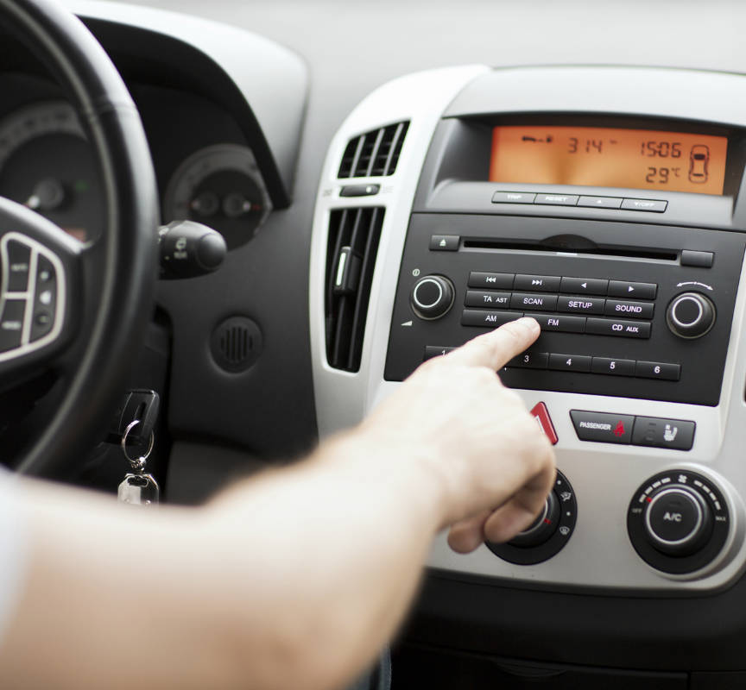
Distracted Driving
Excuses | excuses | excuses
It was an urgent work call!
But I was stopped at a red light.
I was just checking my voicemail.
But I have it on hands-free!
I didn’t know, I’m not from here.
ZERO TOLERANCE
Everybody goes home safely everyday!
Notes:
1. It was an urgent work call! Let callers know on your voicemail that you may be driving and there may be delay before you return their call. Use Do Not Disturb While Driving settings on your phone.
2. But I was stopped at a red light. Put a stop to this misconception: the rules apply even if you are stopped at a light, need to be aware of changes in traffic patterns, pedestrians….
3. I was just checking my voicemail – I didn't make a call. Let voicemail do its job – call back later when it's safe to do so. Better yet, turn your cell phone off or put it in the trunk to avoid the temptation to pick it up.
4. But I have it on hands-free! Hands free still means that your brain is doing something else and not driving
5. I didn't know I'm not from here. The policy applies to every FieldCore employee.

Slide 13



Take the Pledge
#Just drive – end distracted driving
Use the ‘Do Not Disturb’ function on your cell phone while driving
Be flexible in allowing your team to attend calls from home rather than taking them on the road
Be a good passenger and speak out if the driver in car is distracted
If you notice a co-worker driving while on a call, tell them to hang up and call later
Get involved by being the best messenger to your co-workers, family, and friends
How to add ‘do not disturb’ to your phone
DND - Apple
DND – Google Pixel
Notes:
Hopefully you have learned some valuable information about the dangers of distracted driving. Its important to not only follow these policy requirements to help your team examples include
Be understanding if someone does not pick up the phone
If you are leading a call check and make sure no one is driving while on the call
Record calls if people cannot attend because they are on the road
Allow your team flexibility in taking calls that may be during commute times – take the call from home rather than on the road
Also share this information with your family and friends and encourage them to end distracted driving.

Slide 14
Driver Fatigue and Journey management

Slide 15


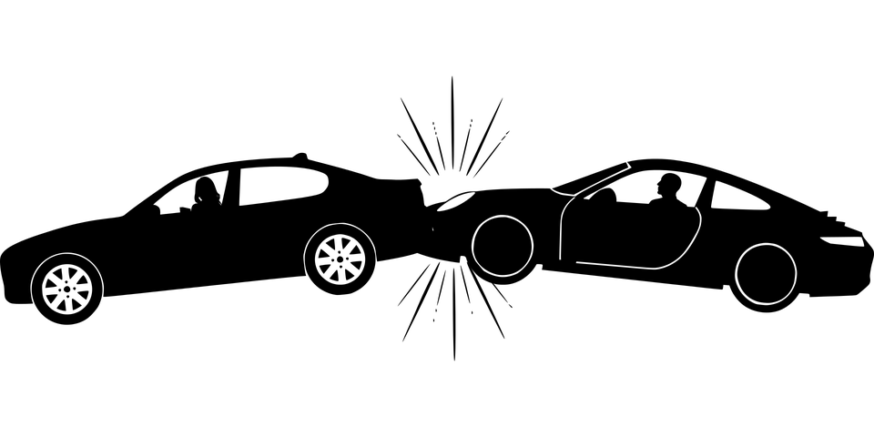
Driver Fatigue
Signs of driver fatigue:
Frequent Yawning
Nodding off
Cant remember last few miles
Missing turns
Difficulty maintaining speed
Drifting out of lane
Risk Factors:
Driving on less than 7 hours of sleep
Driving at night
Changing time zones
Sleep disorders
Working multiple shifts/night shifts
⇒ 21% of all fatal crashes may involve a tired driver
⇒ You are 3x more likely to be in a car crash if you are tired
Notes:
Another risk factor related to driving is fatigue. Its important to be aware of the risk factors and signs of fatigue. Fatigue has a significant impact on being able to drive safely.

Slide 16
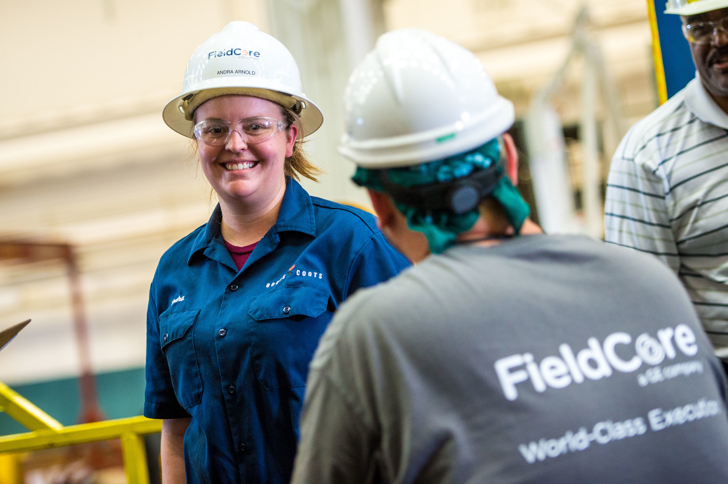

Driver Fatigue Management
What can you do?
For personnel working extended shifts consider proving transportation
Try Carpooling between accommodations and site – passengers reduce risk of nodding off
Pay attention to personnel working night shift or changing shift rotations – increased risk
Follow the working hours and travel hours limits provided in FieldCore’s Fatigue Management Procedure
0810 Fatigue Management Procedure
Notes:
Be familiar with Fatigue Management requirements (See FC-GL-EHS-SAF- 0810 Fatigue Management available on EHS SharePoint). Work hours limitations including travel time must be followed. Pay particular attention to employees driving after night shifts or shift rotations. Consider carpools or providing transport to and from site. When demobilizing consider effects of long shifts followed by long drives home or to the next site.

Slide 17
Plan Route
Consider Time of Day
Work Schedule
Prepare Info
Share Travel Plans
Check in with Contact at Destination
Understand Driving Conditions
Including Weather
Stop – Minimum every 4 Hours
More frequently as needed
Driver
Fatigue
Journey Management
Notes:
One way to manage Drive Fatigue is conducting Journey Management planning in particular for trips longer that 4 hours. Your plan should include understanding the route you will be taking; check with others who have been to that location. Are there any road conditions you should be aware of? Consider the time of day that you will be traveling plus your work schedule if you just finished a long shift consider resting first before beginning your drive. If you have to drive at night consider breaking up your trip to rest for the night. Share your travel plans with your manager or a contact at the site - check in with them when you have arrived, or if you have a change in plans that will delay your arrival. Plan for breaks along the way. Look out for your coworkers as well.
Guidance on Journey Management is included in the Motor Vehicle Safety Procedure – if you have a trip where you will be driving more than 4 hours put a plan together. The guidance document includes options for planning depending upon the particular trip they may be as simple as knowing your route, planning on breaks, and letting people know about your trip. Other trips may require more elaborate planning.

Slide 18
Pedestrian & Worker safety around vehicles

Slide 19
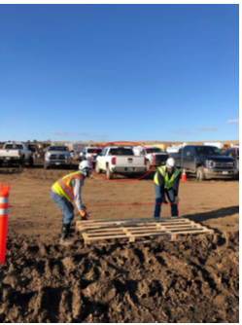
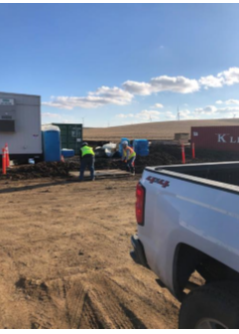
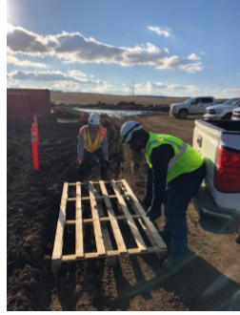
Safety Around Vehicles
When working in areas where vehicles are parked or moving . . .
Wear reflective or brightly colored safety vest of jacket
Set up cones around the work area
If there is active vehicle movement, have someone on the crew act as an observer
Notes:
Motor Vehicle safety does not end when the drive is over. At many job sites there may be risks presented by vehicle movement in and around the work area. Often during outages sites are crowded with limited parking or laydown space.
If you have to use areas near parking lots or roadways as a laydown yard, tool storage or work area take the following precautions:
Wear safety vest or jacket,
Set up cones or bright flagging/tape around the work area.
If vehicles are active have someone on your crew act as an observer or spotter.
Recently at one of our project sites an employee was backed into by a contractors vehicles – it is very fortunate the employee was not injured. You don’t know what the drivers are thinking and they may be distracted - look out for yourself and your coworkers.

Slide 20
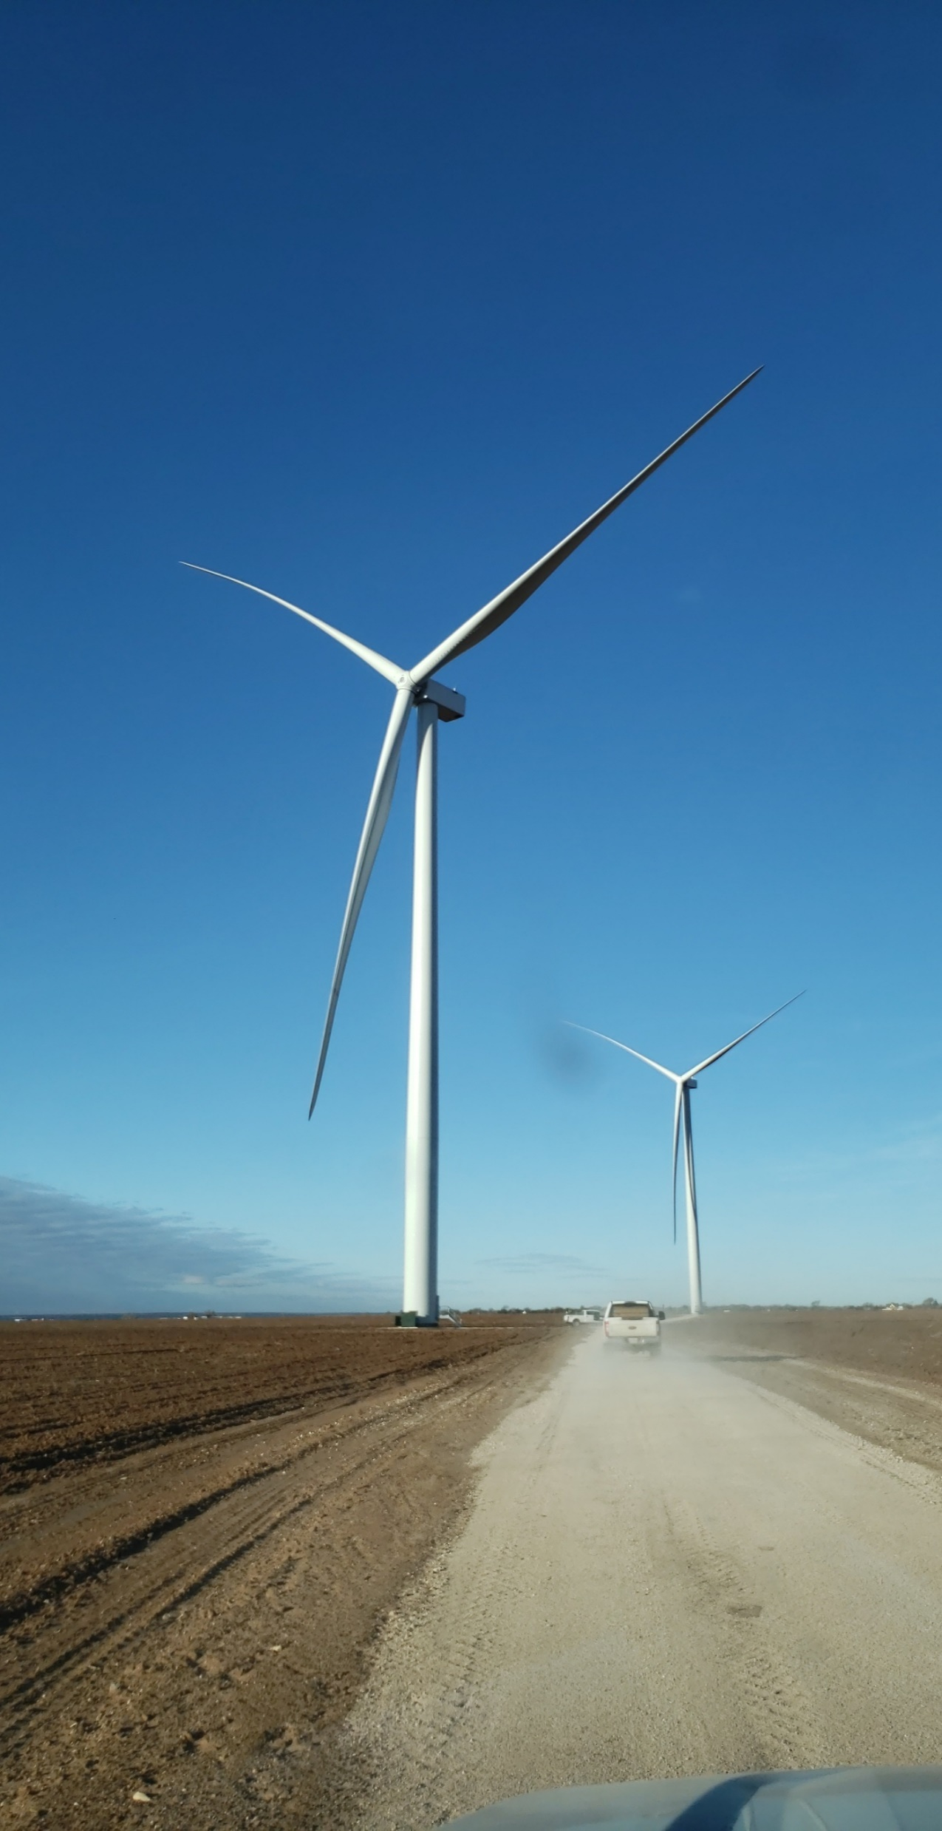
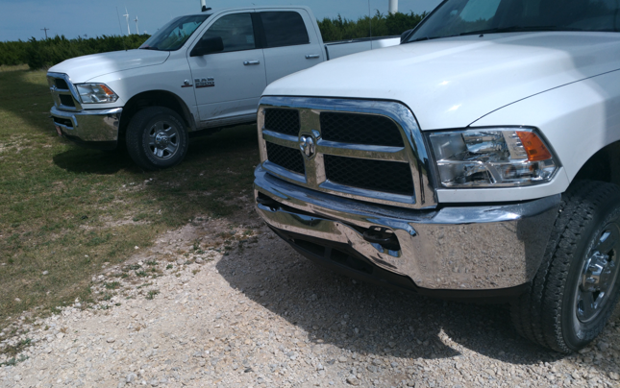
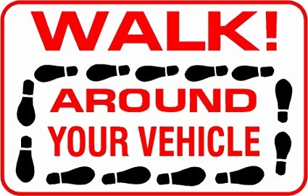
Safety Around Vehicles
Parking Areas:
Look for conditions such as debris, mud, and ice
In windy conditions, take care as vehicle doors can slam shut
It’s recommended to back vehicles into spaces
Check for work activity – If work activity is taking place, use a spotter when backing up
Notes:
Many of the job sites that we work with have limited or unpaved parking areas. When parking take the time to check conditions in the area – we have had several injuries this year that may have been prevented by a quick assessment of conditions before exiting vehicle. Reverse parking is recommended but if that’s not possible be sure to check for work activity when backing up. Use a spotter if people are working in the area.

Slide 21
Vehicle Inspection, Maintenance & Safety Features
Notes:
NOTE: THE CHANGES IN THIS SECTION APPLY TO DRIVERS OF TOOLS OF TRADE VECHICLES ONLY AT THIS TIME – IE EMPLOYEES WHO ARE PROVIDED TRUCKS OR VANS FOR DAILY USE AT JOB SITES

Slide 22

Inspection and Maintenance Standards
WALK
Establishes inspection requirements for Fleet Vehicles – Focus on trucks and heavy use vehicles
Updates to standard safety features on Company Owned and Leased Vehicles
Ensure that vehicles are in safe condition for use – complete a pre-check walk around vehicles
360˚
STRATEGY
AROUND
Notes:
NOTE: Additional inspection requirements apply TO DRIVERS OF TOOLS OF TRADE VECHICLE ONLY AT THIS TIME – i.e., EMPLOYEES WHO ARE PROVIDED TRUCKS OR VANS FOR Regular USE AT JOB SITES - this new requirement is for a documented weekly inspection that is to be kept with the vehicle. A form to capture inspections is provided in the procedure

Slide 23
Training
Notes:
NOTE: THE CHANGES IN THIS SECTION APPLY TO DRIVERS OF TOOLS OF TRADE VECHICLES ONLY AT THIS TIME – IE EMPLOYEES WHO ARE PROVIDED TRUCKS OR VANS FOR DAILY USE AT JOB SITES

Slide 24

Training
As part of program implementation, FieldCore will be developing and rolling out enhanced training for higher risk drivers. e.g. employees assigned fleet vehicles
Time frame 2nd half 2019 into 2020
Certain Regions and Segment are rolling out enhanced training. e.g. NAM Wind Fleet
Selection will be based upon region and segment needs and risk profiles
Standard Training – All Employees
Defensive Driver Training | Online via Success Factors
Next Steps - Additional Training
Extended Classroom Training | Targeted Online Training
In Vehicle – Instructor Training | Use of Driving Simulators

Slide 25
Takeaway

Slide 26
Takeaway
The Motor Vehicle Safety Pledge is another expression of our care for our team.
As a leader of your team
R – Reinforce the message
E – Embrace the change
A – Act as a coach and mentor
D – Demonstrate credibility
PLAN.
PREPARE.
DRIVE.
Take the Pledge!
#JustDrive

Slide 27
Everybody goes home safely everyday!

